Slide 1
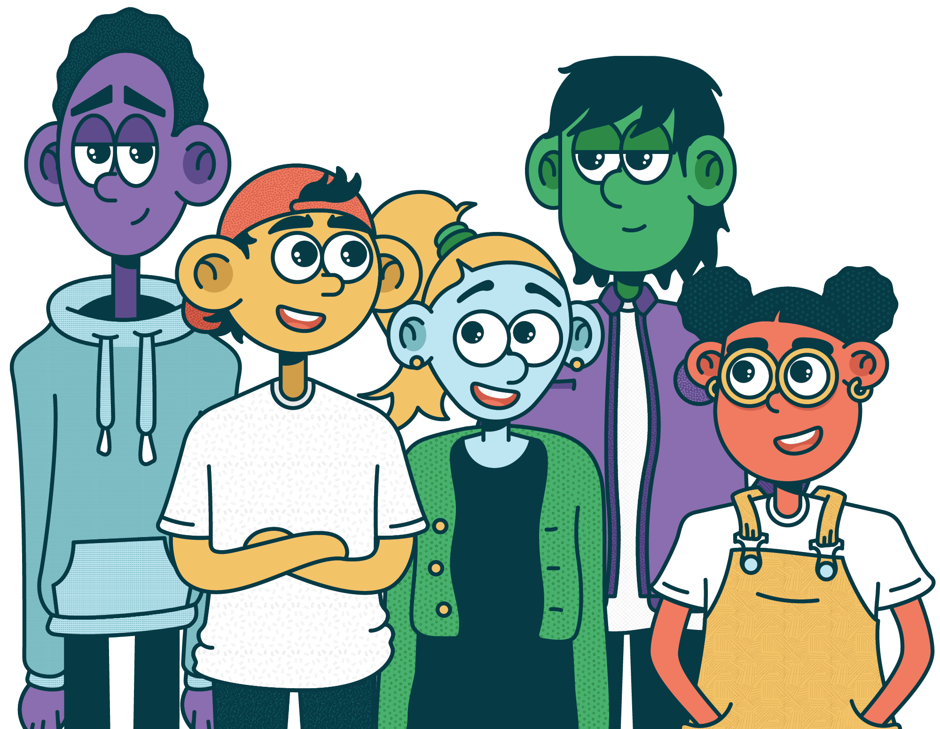


Talk About Tobacco
WITH YOUR KIDS

Slide 2



The Truth:
Kids report vaping as young
as 11.
60% of parents whose kids vape don’t know it’s happening.
21.8% of Oklahoma high school students report vaping.

Slide 3


Slide 4

The Power of Conversation
Your words have power. Talk early, talk often.
Notes:
Talking with your kids in a comfortable, familiar space about the dangers may feel awkward — but it can make a huge difference. Lead with empathy, not judgment, and allow space for questions.

Slide 5
FREE Resources
from Talk About Tobacco

Slide 6
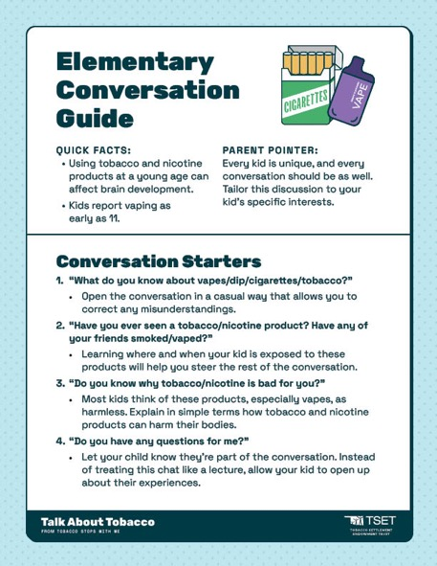
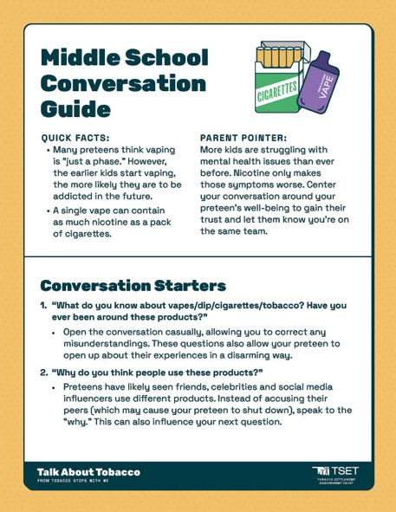
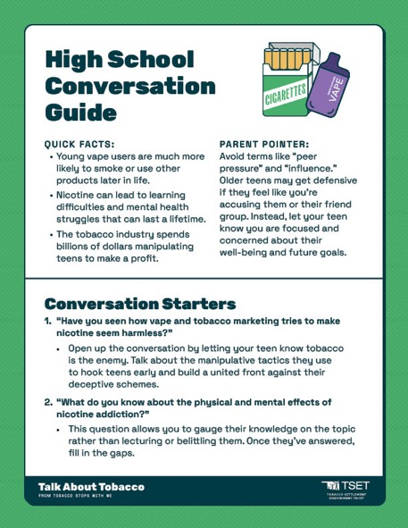
Age-Specific Conversation Guides
Elementary
Middle School
High School
Notes:
Find guides to help your conversation flow at TalkAboutTobacco.com. Each one has age-appropriate statistics and questions to help you get started.

Slide 7
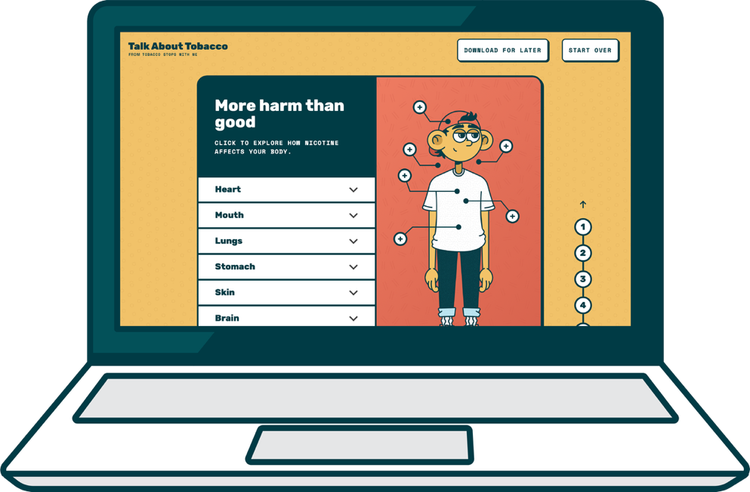
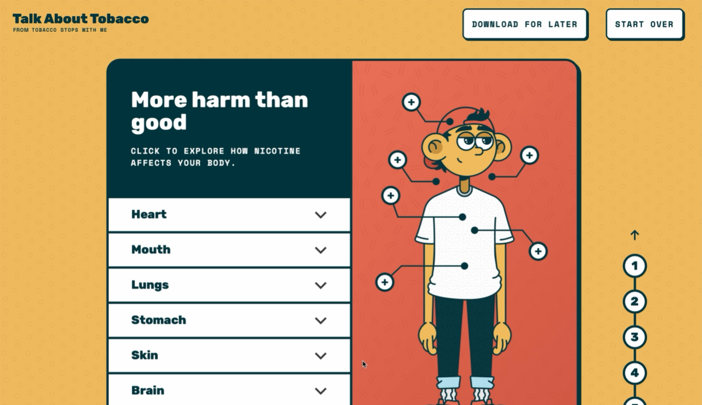
The Interactive Experience
Notes:
If you don’t know where to start, the interactive experience from Talk About Tobacco is a memorable way to learn about the dangers of vaping. Go through it with your child to learn more.

Slide 8

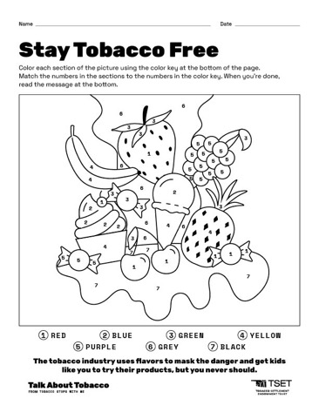
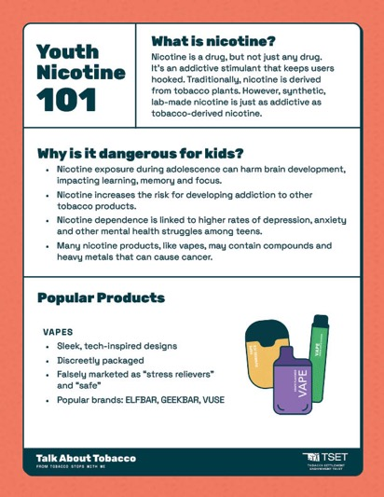
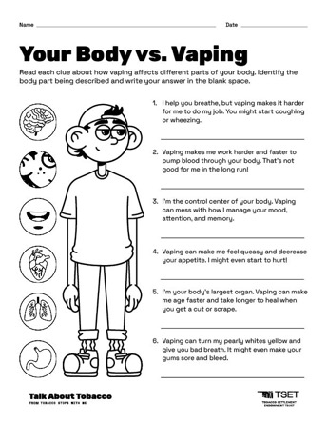
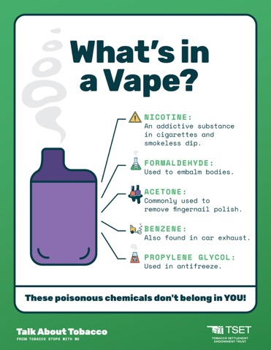

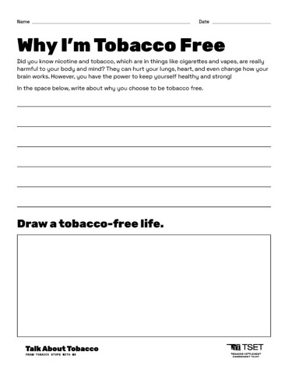
More Resources
Notes:
You can also visit TalkAboutTobacco.com for more guides and information. Educators can also find free resources to encourage healthy decisions in their classroom.

Slide 9
